Slide 1
Accessibility coaching session series
February, 2020
Version 1.0
Roch Lambert, CPWA – IT Accessibility Office (ITAO)
Notes:
Part of the Accessibility Compliance Project

Slide 2
Housekeeping
Coaching hours
  9am to 12pm (half day) / 4pm (full day)
Breaks
  10h30 / 14h15 (full day)
Interactive sessions
Participant’s list (AM / PM (full day))
Blackberry’s and cellphones on silent
Course references
Remote attendees / Webex
A moderator will monitor the chat, we’ll let you know who that is. The line may be on mute, especially if there is too much background noise.
During exercises you can ask the moderator any questions and if necessary we’ll make sure those questions are transferred to the class.
Notes:
Shawn will monitor the chat
Don’t forget to mute all lines
References : https://bati-itao.github.io/coaching_sessions/accessibility-fr.html

Slide 3
Introductions and welcome
In turn, introduce yourself to the group:
Your name
Where you work
Talk about your position
HTML experience
Accessibility experience
What you expect from this coaching
Notes:
Start by introducing myself
Manager in the IT Accessibility Office (Strategy and Awareness)
CPWA certified / 15 years in IITB and 12+ years in accessibility
Teacher at CSPS for 8+ years for the accessibility courses (T710/T711/T716)

Slide 4
Purpose
Introduction to accessibility (web / non-web), focusing on the ability to
self-assess the compliance level of your asset.
Part 1 – All about accessibility
Part 2 – Context for disabilities in Canada
Part 3 – Overview of accessibility tools
Part 4 – Web Content Accessibility Guidelines
Part 5 – Self assessment checklists
Part 6 – Resources and contacting the ITAO

Slide 5

All about accessibility

Slide 6

What is accessibility to you?
Definition
What is the difference between accessibility and usability?
What is a disability?
Is accessibility all about disability?
Notes:
- Use the example of someone who has their hands full who needs to open a door. Someone who broke a leg and uses the ramps.

Slide 7
Definitions
Web accessibility
  The qualities that make a web experience available to the widest possible group of users independent of ability or disability.
Usability
  The qualities that make a web experience intuitive and easy to use. A usable web design aligns with the purpose for which the web site was created.
Disability
  A disability is any continuing condition that restricts everyday activities.

Slide 8
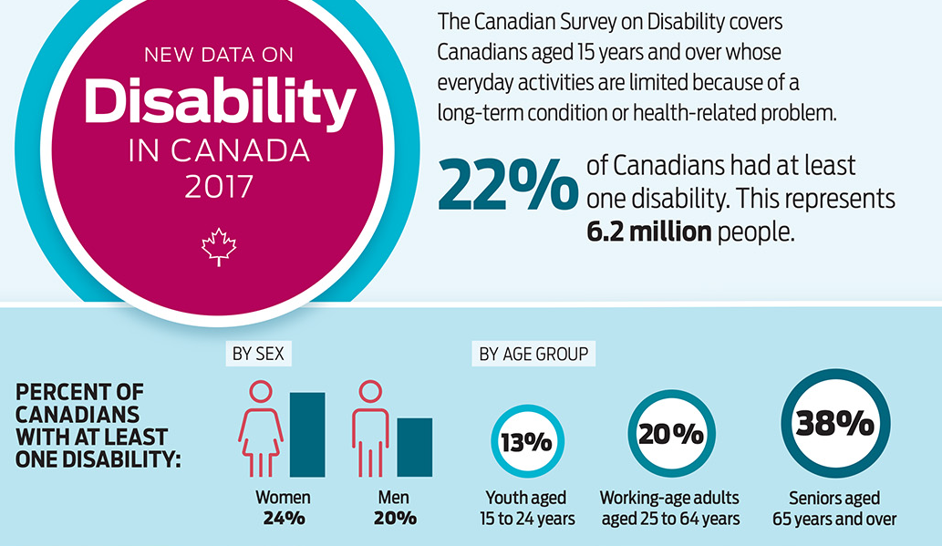
Disabilities in Canada

Slide 9
Prevalence of disability by type, 2017
Disability Type | Percentage
Pain | 15
Flexibility | 10
Mobility | 10
Mental/Psychological | 7
Dexterity | 5
Hearing | 5
Seeing | 5
Memory | 4
Learning | 4
Developmental | 1
Source : New Data on Disability in Canada, 2017

Slide 10

Deep dive into disabilities
Disabilities are often broken down into four broad categories:
Visual
Auditory
Motor-skills
Cognitive
Notes:
Talk about temporary VS permanent disabilities
Invisible disabilities

Slide 11
Visual disabilities include:
Low vision
  Vision loss that cannot be corrected with glasses
  • Macular degeneration
  • Glaucoma
  • Diabetic retinopathy
  • Cataract
Colour blindness
  • Protanopia (red deficiencies)
  • Deuteranopia (green deficiencies)
  • Tritanopia (blue deficiencies)
  • Rod monochromacy (no colour)
Blindness
  Which includes very little to no vision
  • Visual acuity is 20/200 or less in both eyes after correction, and/or
  • A visual field of 20 degrees or narrower.

Slide 12
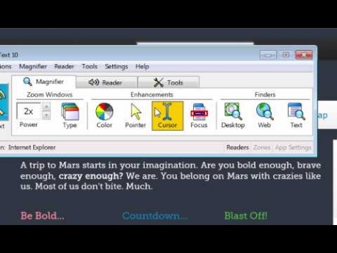
Introduction to low vision tools (video)
Notes:
Video : https://www.youtube.com/watch?v=ojtiVj78QPw

Slide 13
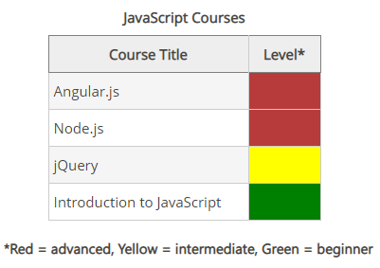
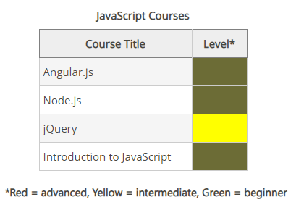
Example of red-green colour-blindness
Notes:
We see this all the time in project related updates
Even to get on highway 50 from Allumetières

Slide 14
Visual disabilities simulation
Simulation using the Zimmerman low vision simulation kit
Notes:
For Webex : https://www.youtube.com/watch?v=VIRx3RJzbZg&list=PL6J3hNm0YtpMJr4fGNHyU5vIPd8cZWcEx (5 part series)

Slide 15
Auditory disabilities include:
Mild
  Sounds below 30 decibels
  For people with mild hearing loss, speech can be difficult to understand, especially if background noises are present.
Moderate
  Sounds below 50 decibels
  For people with moderate hearing loss, a hearing aid may be required.
Severe
  Sounds below 80 decibels
  For people with severe hearing or profound loss, communication may be done through sign language; others rely on lip-reading techniques.
Profound
  Sounds below 95 decibels
  Any sound in some cases
Notes:
- Talk about Angèle her desk placement

Slide 16
Motor-skill disabilities include:
Traumatic injuries
  • Spinal cord injury
  • Loss or permanent damage to limb(s)
Diseases & Congenital Conditions
  • Cerebral palsy
  • Muscular dystrophy
  • Multiple sclerosis
  • Spina bifida
  • ALS (Lou Gehrig’s Disease)
  • Arthritis
  • Parkinson’s disease

Slide 17
Cognitive disabilities
By far the most common type of disability is cognitive disabilities. Cognitive disabilities can arise as a result of congenital conditions that are with an individual from birth, or developmental conditions that are with a person from a young age. They can also result from traumatic injury, infections, chemical imbalances, or other conditions later in life.
In simple terms, a person who has a cognitive disability has trouble performing mental tasks that the average person would be able to do.
This category includes:
• Intellectual disability
• Developmental delay and/or disability
• Learning disabilities such as Dyslexia and ADHD.
Notes:
- Cognitive also include speech disabilities which we don’t focus on as much in an IT world

Slide 18
Cognitive disabilities for IT consideration
Limited Comprehension
  Inability to understand complex ideas.
Low Tolerance for Cognitive Overload
  Frustration when sensing difficult situations, or when there are too many things in their environment happening at the same time.
Limited Problem-Solving Skills
  When presented with a problem to solve, some people with cognitive disabilities may simply be unable to solve it.
Short-Term Memory Loss
  May have a hard time remembering things from one moment to the next. Inability to focus on new information, so they don't retain it in the short term.
Notes:
- Short-Term memory loss : Long web processes—such as online purchasing procedures, account sign-up procedures, or setting preferences—can cause users to forget what they were doing, or to lose track of information that they may need to remember from one step to the next.

Slide 19
Cognitive disabilities for IT consideration
Attention Deficit
  Some users experience attention deficits, making it hard for them to focus on the task at hand.
Difficulty Reading
  Many people with cognitive disabilities experience difficulty reading. Some read at a lower level than their peers of the same age, and some can't read at all.
Difficulty Understanding or Using Math
  Some people experience math anxiety, which is an emotional or psychological fear that grips some people when confronted with math problems. This is less of an intellectual deficit than a psychological deficit.
Seizures
  Seizures are abnormal or erratic electrical impulses in the brain that interfere with a person's ability to process information or, in some cases, control voluntary muscle movement.

Slide 20
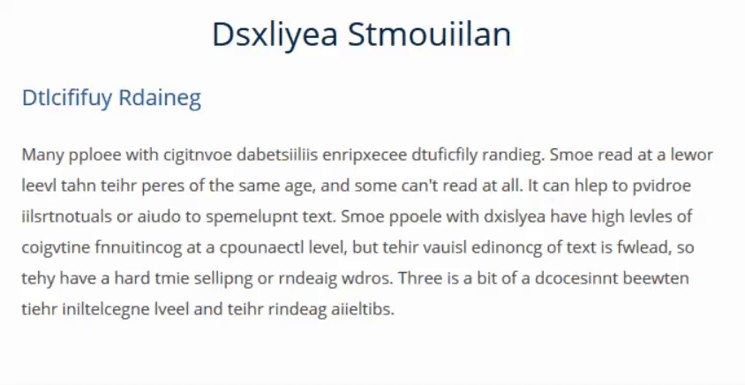
Dyslexia Simulation

Slide 21
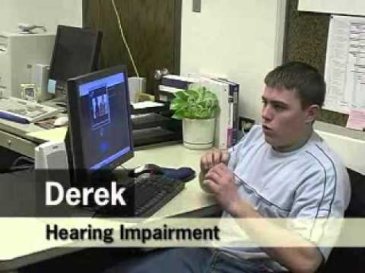
Experiences of Students with Disabilities

Slide 22
Assistive technologies
Assistive technologies are products, equipment and systems that enhance activities for people with disabilities.
For digital accessibility, Assistive Technologies are often broken down into two categories:
  Input devices
  Output devices
Input devices aid people when interacting with websites and applications.
Output devices aid people when presenting information from websites and applications.

Slide 23

Input devices
Input devices include:
Accessible keyboards, Track pads, Head wands, Mouth pieces, Puffers, Switches, Touch screens, Eyetrackers, Voice activation software, etc.
Notes:
Video : https://www.youtube.com/watch?v=ZMvikz2cA-8

Slide 24
Output devices
Output devices include:
Magnifiers, Screen Readers, Refreshable Braille Devices etc.
Notes:
Video : https://www.youtube.com/watch?v=JDl7_0wU8xY

Slide 25

Context for disabilities in Canada

Slide 26
Rights to accessible service
Background
  Accessible Canada Act (Bill C-81)
  ASC / CASDO
  The Donna Jodhan case (2010)
  Government policy on communications
  Canadian Human Rights Act – Sections 3, 5, 7 and 10
  Canadian Charter of Rights and Freedoms –Section15(1)

Slide 27
Context – The Accessible Canada Act
The Accessible Canada Act (Act) came into effect July 11, 2019. This will benefit everyone in Canada, especially persons with disabilities, by helping to create a barrier-free Canada.
  Requires the government to create accessibility standards and regulations in priority areas: employment, built environment, procurement, transportation, communications, program and service design and delivery, information and communications technologies.
  Applies to sectors under federal jurisdiction.
Key goals:
  Identify, remove and prevent barriers to accessibility.
  Bring leadership and cohesion to federal efforts to improve accessibility.
  Create more consistent experiences of accessibility across Canada.
Under the legislation, all federally-regulated organizations, including ESDC, will be required to:
  Prepare and publish an Accessibility Plan developed in consultation with persons with disabilities (first Plan to be published in 2022).
  Establish a process for receiving and addressing feedback from employees and clients.
  Report publicly on progress achieved.
A transformational shift in addressing disability and accessibility barriers through a proactive approach.
Notes:
- Important to note that the act is not prescriptive, CASDO will recommend those.

Slide 28
Context – Accessibility Standards Canada (ASC) / Canadian Accessibility Standards Development Organization (CASDO)
Technical committees will consult with experts in order to develop accessibility standards for people with disabilities. ASC will make recommendations to the minister responsible to adopt as regulations.
Will conduct research on identifying and removing barriers, and disseminate information about best practices.
Persons with disabilities will lead ASC. The aim is for the majority of board members to be Canadians with disabilities.

Slide 29
Context – The Public Service Accessibility Strategy
Treasury Board Secretariat (TBS) released the Public Service Accessibility Strategy in May 2019 to help federal departments meet the requirements of the Act.
  Based on results from broad consultations with thousands of public servants and experts on how to make the Government of Canada the most accessible and inclusive public service in the world.
Strategy identifies 5 goals for action at the Government-wide level and at the Departmental level, along with specific measures of success to be achieved by 2021:
  Improving recruitment, retention, and promotion of persons with disabilities.
  Enhancing the accessibility of the built environment.
  Making information and communications technology (ICT) usable by all.
  Equipping public servants to design and deliver accessible programs and services.
  Building an accessibility-confident public service.
The Strategy provides guidance for departments to assess the state of accessibility in their organization, take early action in areas where immediate improvements can be made and set out a plan for achieving sustainable and tangible progress over time.

Slide 30
Information and Communication Technology (ICT)
Current state:
Desired state (proposed):
ESDC employees and clients can access and use all ICT regardless of ability or disability
All IITB processes take into consideration accessibility, where applicable, from the start of projects to create inclusive environments
91% of ESDC internal applications do not meet accessibility standards
88% of commercial-of-the-shelf products for staff do not meet accessibility standards
Average resolution time for an IT assistive technology request is currently 30 days
Some ICT processes already include Accessibility considerations.
On flight ICT projects did not include Accessibility in the requirements
Well established assessment process for ICT accessibility in place.
Central ICT intake process for Accessibility
Measures of success by 2025 (proposed):
100% ICT products acquired are accessible
100% new ICT contracts have accessibility requirements as of 2020
Internal solutions (ITRDS, NWS) that meet accessibility standards increased to 25 % by 2021, 60% by 2022 and 100% by 2025
Off-the-shelf products (e.g. PeopleSoft) that are accessibility compliant increased to 25% by 2022, 50% by 2023 and 100% by 2025
100 % of employees requiring an accessible workstation have one
ESDC employees with disabilities have improved access to pensions applications
Notes:
- Talk about Section 508 for accessibility

Slide 31
Guideline on Making Information Technology Usable by All
In a nutshell the guidance indicates:
Leverage Harmonised European Standard, EN 301 549 (2018) when:
  Acquiring or developing internal-facing or public-facing IT solutions and equipment, including web content and all IT tools and equipment used by federal public servants.
  Considering accessibility in the lifecycle management process for existing IT solutions and equipment, including web content.
In alignment with the Harmonised European Standard, EN 301 549 (2018), departments, agencies and organizations are strongly encouraged to follow the latest version of the Web Content Accessibility Guidelines (WCAG) 2.1 AA (2018).
Departments, agencies and organizations are strongly encouraged to:
  Ensure that accessibility features are enabled for their IT solutions and equipment.
  Leverage enterprise tools and capacity to ensure that internal‑facing IT solutions and equipment are accessible for public servants.
  Work with the IT Accessibility Office (ESDC) to identify and deploy accessible tools and technology, and to remove remaining accessibility barriers associated with IT.
  Leverage their existing in-house accessibility programs when meeting Government of Canada accessibility requirements.
  Work in the open and use open‑source software to support others in efforts to develop accessible common IT systems across departments, agencies and organizations.

Slide 32
Accessibility Compliance Project
Current state analysis reveals 303 internal applications and over 500+ software products ( Commercial-off-the shelf, freeware, open source or other government commissioned products) in-scope for this project.
The mandate of the project is to render all applications/products accessible by 2025.
This project will model its strategy based on what was used for external client facing solutions by
Using an Incremental prioritized approach.
Harmonizing accessibility changes with other planned enhancements to minimize costs and risks to operations.
Utilizing a planned and phased approach to meet our goals.
Questions ? EDSC.PCA-ACP.ESDC@hrsdc-rhdcc.gc.ca
Project Share Point : Compliance Project

Slide 33
Overview of accessibility tools
Colour Contrast Analyzer
WAVE Firefox / Chrome Extension
Complex Data Table Markup Toolbar
Firebug (deprecated) / F12 developer tools
HTML_CodeSniffer
Nordburg.ca
aXe testing from Deque
Bookmarklets from Digital A11Y
Compliance Deputy / Compliance Sheriff

Slide 34
The structure of WCAG 2.1
Principles (4)
  Guidelines (13)
    Success criteria - 50 (A and AA) / 78 (AAA)
      Sufficient techniques
      Advisory techniques*
      Common failures
Conformance requirements
* Advisory techniques are not required for conformance

Slide 35
The structure of WCAG 2.1 (cont’d)
Technique Structure:
    Applicability
    Description
    Examples
    Resources
    Related techniques
    Tests

Slide 36
Four principles of accessibility (POUR)
Perceivable
  Available through sight, hearing, or touch
Operable
  Compatible with keyboard
Understandable
  User-friendly, easy to comprehend
Robust
  Follows standards and works across all browsers, assistive technologies, and mobile devices

Slide 37
Is the web page perceivable?
  Information and user interface components must be presentable to users in ways they can perceive.
Do images have alternative text?
Is the tab order and read order logical and intuitive?
Have you avoided using visual characteristics to communicate information (e.g., “click the circle on the right” or “required fields are in red”)?
Does the interface have sufficient contrast between text color and background color?
Does the content scale well when text is enlarged up to 200 percent?

Slide 38
Perceivable – Deep dive
GUIDELINE 1.1 – TEXT ALTERNATIVES
  Success Criteria 1.1.1 Non-text Content (a)
GUIDELINE 1.2 – TIME-BASED MEDIA
  Success Criteria 1.2.1 audio-only and video-only (prerecorded) (a)
  Success Criteria 1.2.2 captions (prerecorded) (a)
  Success Criteria 1.2.3 audio description or media alternative (prerecorded) (a)
  Success Criteria 1.2.4 captions (live) (aa)
  Success Criteria 1.2.5 audio description (prerecorded) (aa)
GUIDELINE 1.3 – ADAPTABLE:
  Success Criteria 1.3.1 info and relationships (a)
  Success Criteria 1.3.2 meaningful sequence (a)
  Success Criteria 1.3.3 sensory characteristics (a)
  Success Criteria 1.3.4 orientation (aa)
  Success Criteria 1.3.5 identify input purpose (aa)
GUIDELINE 1.4 – DISTINGUISHABLE:
  Success Criteria 1.4.1 use of color (a)
  Success Criteria 1.4.2 audio control (a)
  Success Criteria 1.4.3 contrast (minimum) (aa)
  Success Criteria 1.4.4 resize text (aa)
  Success Criteria 1.4.5 images of text (aa)
  Success Criteria 1.4.10 reflow (aa)
  Success Criteria 1.4.11 non-text contrast (aa)
  Success Criteria 1.4.12 text spacing (aa)
  Success Criteria 1.4.13 content on hover or focus (aa)

Slide 39
Is the web page operable?
User interface components and navigation must be operable.
Can all menus, links, buttons, and other controls be operated by a keyboard, to make them accessible to users who are unable to use a mouse?
Does the web page include a visible focus indicator so that all users, especially those using a keyboard, can easily track their current position?
Do features that scroll or update automatically (e.g., slideshows, carousels) have prominent accessible controls that enable users to pause or advance these feature on their own?
Do pages that have time limits include mechanisms for adjusting those limits for users who need more time?

Slide 40
Operable – Deep dive
GUIDELINE 2.1 – KEY BOARD ACCESSIBLE
  Success Criteria 2.1.1 keyboard (a)
  Success Criteria 2.1.2 no keyboard trap (a)
  Success Criteria 2.1.4 character key shortcuts (a)
GUIDELINE 2.2 – ENOUGH TIME
  Success Criteria 2.2.1 timing adjustable (a)
  Success Criteria 2.2.2 pause, stop, hide (a)
GUIDELINE 2.3 – SEIZURES
  Success Criteria 2.3.1 three flashes or below threshold (a)
GUIDELINE 2.4 – NAVIGABLE
  Success Criteria 2.4.1 bypass blocks (a)
  Success Criteria 2.4.2 page titled (a)
  Success Criteria 2.4.3 focus order (a)
  Success Criteria 2.4.4 link Purpose (in context) (a)
  Success Criteria 2.4.5 multiple ways (aa)
  Success Criteria 2.4.6 headings and labels (aa)
  Success Criteria 2.4.7 focus visible (aa)
GUIDELINE 2.5 – INPUT MODALITIES
  Success Criteria 2.5.1 pointer gestures (a)
  Success Criteria 2.5.2 pointer cancellation (a)
  Success Criteria 2.5.3 label in name (a)
  Success Criteria 2.5.4 motion actuation (a)

Slide 41
Is the web page understandable?
Information and the operation of user interface must be understandable.
Can the language of the page, and any changes in language, be programmatically determined?
Is there enough information related to interactive elements for all users to be able to successfully interact with the page (including error handling)?
Do elements repeated across pages appear in the same relative order?
Does the content follow the Canada.ca Content Style Guide?

Slide 42
Understandable – Deep dive
GUIDELINE 3.1 – READABLE
  Success Criteria 3.1.1 language of page (a)
  Success Criteria 3.1.2 language of parts (aa)
GUIDELINE 3.2 - PREDICTABLE
  Success Criteria 3.2.1 on focus (a)
  Success Criteria 3.2.2 on input (a)
  Success Criteria 3.2.3 consistent navigation (aa)
  Success Criteria 3.2.4 consistent identification (aa)
GUIDELINE 3.3 – INPUT ASSISTANCE
  Success Criteria 3.3.1 error identification (a)
  Success Criteria 3.3.2 labels or instructions (a)
  Success Criteria 3.3.3 error suggestion (aa)
  Success Criteria 3.3.4 error prevention (legal, financial, data) (aa)

Slide 43
Is the web page robust?
Content must be robust enough that it can be interpreted reliably by a wide variety of user agents, including assistive technologies.
Can users determine the roles, states, and properties of custom elements?
Does the markup language use conform to the concept of being “well formed” according to its specification?

Slide 44
Robust – Deep dive
GUIDELINE 4.1 – COMPATIBLE
  Success Criteria 4.1.1 parsing (a)
  Success Criteria 4.1.2 name, role value (a)
  Success Criteria 4.1.3 status messages (aa)

Slide 45
WCAG conformance requirements
Conformance level
  Conform to level AA (includes all level A)
Full pages
Complete processes
Only accessibility-supported ways of using technologies
  Use technologies that can be relied upon
Non-interference

Slide 46
WCAG final quiz
Final exercise: Quiz on WCAG 2.1
Review of Quiz on WCAG 2.1

Slide 47
Self-assessment checklists
Web Standards Centre of Expertise
  Web Standards CoE checklist
Accessibility Compliance Assessment
  ACA checklist
The checklists cover approx. 70-80% of accessibility requirements that does not require an expert to verify.

Slide 48
Resources
IT Accessibility Office (ITAO)
For 20 Years, under various banners, the IT Accessibility Office has been a provider for adaptive technology and advocate for inclusiveness of people with disabilities in the workplace. We are demonstrated leaders, committed to our accessibility mandate, continuing to provide support to employees with disabilities.
Some of the services offered by the ITAO (full list available on iService) :
  General Advice on an accessible ICT
  Design Advice on an accessible ICT solution
  Accessible Assessments on ICT solution
  Document Review (Outlook, Word, Excel, PowerPoint, PDF)
How to contact us
Website
Send an email
Call and leave a message to 819-654-1071

Slide 49


Questions and answers
Any accessibility question in the official language of your choice!
Roch Lambert, CPACC
Manager, IT Accessibility office - Strategy and Awareness
Employment and Social Development Canada / Government of Canada
roch.lambert@hrsdc-rhdcc.gc.ca / Tel: 819-654-0498 / BlackBerry: 343-542-1013

